Slide 1
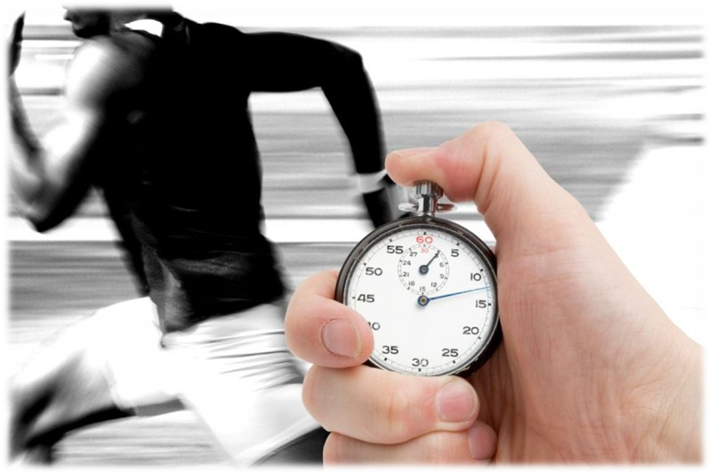
컴퓨터구조
Lecture 4
Performance
Notes:
OK, let’s start today’s lecture with a recap of what you learned last Friday.
Last Wednesday, Professor Dave Patterson gave you a lecture on the MIPS instruction set architecture.
And here are some of the important things you need to keep in mind if you are going to design a new instruction set.
Start Time: X:40
+1 = 1 min. (X:41)

Slide 2
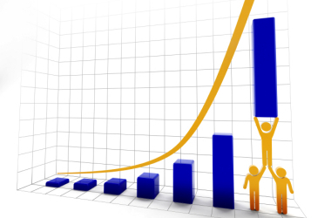
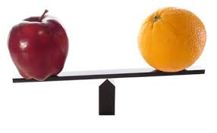
Performance
Purchasing perspective
  given a collection of machines, which has the
    best performance ?
    least cost ?
    best performance / cost ?
Design perspective
  faced with design options, which has the
    best performance improvement ?
    least cost ?
    best performance / cost ?
Both require ?
  basis for comparison
  metric for evaluation
Our goal is to understand cost & performance implications of architectural choices

Slide 3
Two notions of “performance”
Plane
DC to Paris
Speed
Passengers
Throughput (in pmph)
(Speed * Passengers)
Boeing 747
6.5 hours
610 mph
470
286,700
BAD/Sud Concorde
3 hours
1350 mph
132
178,200
Which has higher performance?
° Time to do the task (Execution Time)
– execution time, response time, latency
° Tasks per day, hour, week, sec, ns. .. (Performance)
– throughput, bandwidth
Response time and throughput often are in opposition

Slide 4
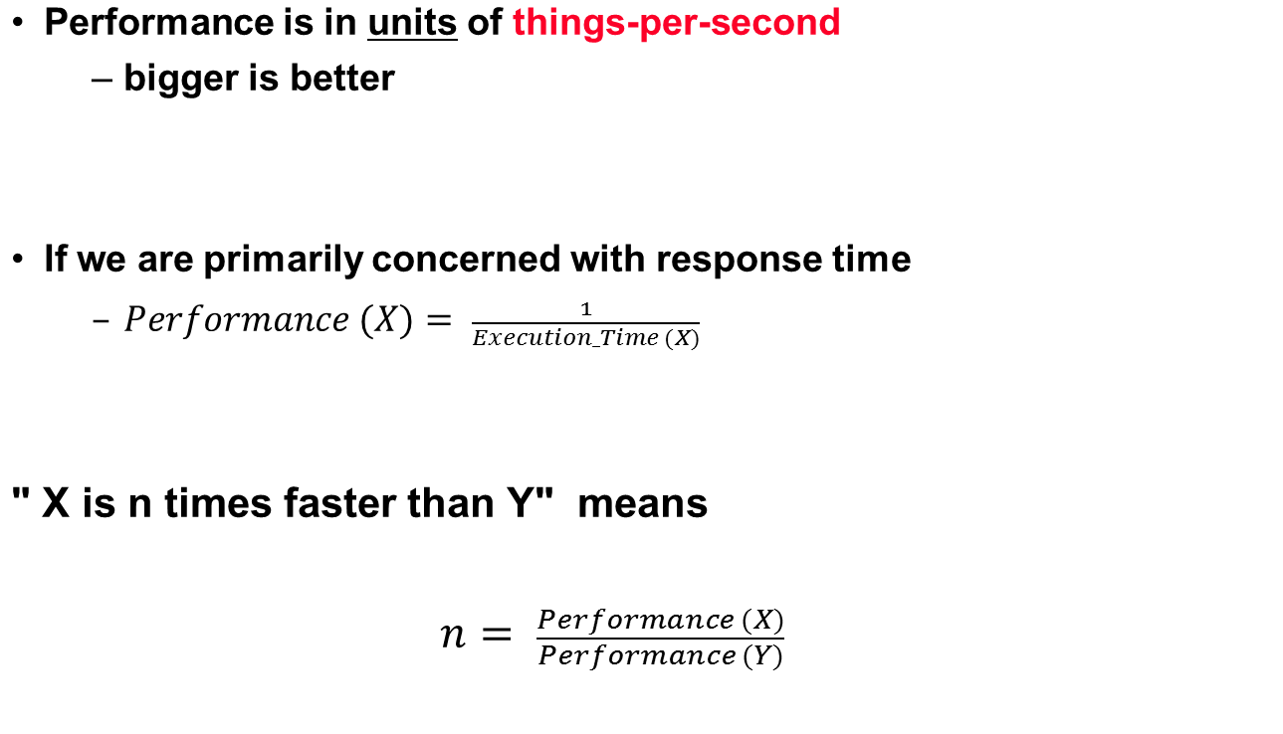
Definitions

Slide 5
Comparing Computer Performance Using Execution Time
To compare the performance of two machines (or CPUs) “A”, “B” running a given specific program:
Performance_{A} = 1 / Execution Time_{A}
Performance_{B} = 1 / Execution Time_{B}
Machine A is n times faster than machine B means (or slower? if n < 1) :
Example:
For a given program:
  Execution time on machine A: Execution_{A} = 1 second
  Execution time on machine B: Execution_{B} = 10 seconds
  Performance_{A} / Performance_{B} = Execution Time_{B} / Execution Time_{A}
  = 10 / 1 = 10
  The performance of machine A is 10 times the performance of
  machine B when running this program, or: Machine A is said to be 10
  times faster than machine B when running this program.
Performance_{A}
Execution Time_{B}
Speedup = n = =
Performance_{B}
Execution Time_{A}
(i.e Speedup is ratio of performance, no units)
Speedup=
The two CPUs may target different ISAs provided
the program is written in a high level language (HLL)

Slide 6
Example
Time of Concorde vs. Boeing 747?
  Concord is 1350 mph / 610 mph = 2.2 times faster
  = 6.5 hours / 3 hours
Throughput of Concorde vs. Boeing 747 ?
  Concord is 178,200 pmph / 286,700 pmph = 0.62 “times faster”
  Boeing is 286,700 pmph / 178,200 pmph = 1.60 “times faster”
Boeing is 1.6 times (“60%”) faster in terms of throughput.
Concord is 2.2 times (“120%”) faster in terms of flying time.
We will focus primarily on execution time for a single job
Lots of instructions in a program → Instruction throughput important!

Slide 7
CPU Execution Time: The CPU Equation
A program is comprised of a number of instructions executed , I
  Measured in: instructions/program
The average instruction executed takes a number of cycles per instruction (CPI) to be completed.
  Measured in: cycles/instruction, CPI
CPU has a fixed clock cycle time C = 1/clock rate
  Measured in: seconds/cycle
CPU execution time is the product of the above three parameters as follows:
AKA Dynamic Executed Instruction Count
Or Instructions Per Cycle (IPC):
IPC = 1/CPI
C = 1 / f
Executed
CPU time = Seconds = Instructions x Cycles x Seconds
Program Program Instruction Cycle
T = I x CPI x C
execution Time
per program in seconds
Number of
instructions executed
Average CPI for program
CPU Clock Cycle time
(This equation is commonly known as the CPU performance equation)

Slide 8
CPU Average CPI/Execution Time
For a given program executed on a given machine (CPU):
CPI = Total program execution cycles / Instructions count
→ CPU clock cycles Count = Instruction count x CPI
CPU execution time =
= CPU clock cycles count x Clock cycle
= Instruction count x CPI x Clock cycle
T = I x CPI x C
(i.e average or effective CPI)
Executed (I)
(executed, I)
execution Time
per program in seconds
Number of
instructions executed
Average
or effective
CPI for
program
CPU Clock Cycle
(This equation is commonly known as the CPU performance equation)
CPI = Cycles Per Instruction

Slide 9

Basis of Evaluation
Pros
Cons
very specific
non-portable
difficult to run, or
measure
hard to identify cause
representative
Actual Target Workload
portable
widely used
improvements useful in reality
Full Application Benchmarks
less representative
easy to run, early in design cycle
Small “Kernel”
Benchmarks
easy to “fool”
identify peak capability and potential bottlenecks
“peak” may be a long way from application performance
Microbenchmarks

Slide 10
SPEC95
Eighteen application benchmarks (with inputs) reflecting a technical computing workload
Eight integer
  go, m88ksim, gcc, compress, li, ijpeg, perl, vortex
Ten floating-point intensive
  tomcatv, swim, su2cor, hydro2d, mgrid, applu, turb3d, apsi, fppp, wave5
Must run with standard compiler flags
  eliminate special undocumented incantations that may not even generate working code for real programs

Slide 11
Metrics of performance
Seconds per program
Useful Operations per second
Application
Programming
Language
Compiler
(millions) of Instructions per second – MIPS
(millions) of (F.P.) operations per second – MFLOP/s
ISA
Datapath
Control
Megabytes per second
Function Units
Transistors
Wires
Pins
Cycles per second (clock rate)
Each metric has a place and a purpose, and each can be misused

Slide 12
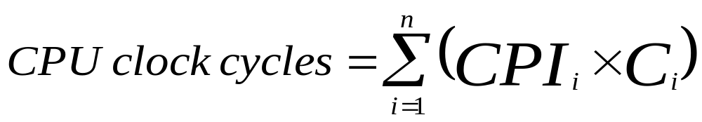
Instruction Types & CPI
Given a program with n types or classes of instructions executed on a given CPU with the following characteristics:
  C_{i} = Count of instructions of type_{i} executed
  CPI_{i} = Cycles per instruction for type_{i}
Then:
CPI = CPU Clock Cycles / Instruction Count i
  Where:
  Executed Instruction Count i = Σ C_{i}
e.g ALU, Branch etc.
i = 1, 2, …. n
Depends on CPU Design
i.e average or effective CPI
Executed
T = I x CPI x C

Slide 13

CPI
“Average cycles per instruction”
CPI_{ave} = (CPU Time * Clock Rate) / Instruction Count
  = (CPU Time * )/ Instruction Count
  = Clock Cycles / Instruction Count
Fraction of total execution time for instructions of type i :
n
CPU time = ClockCycleTime * Σ CPI * C
i = 1
i
i
n
"instruction frequency"
CPI = Σ CPI * F where F = C
i
i
i
i
i = 1
Total Instruction Count
Invest Resources where time is Spent!

Slide 14
Aspects of CPU Execution Time
CPU Time = Instruction count executed x CPI x Clock cycle
T = I x CPI x C
Depends on:
Program Used
Compiler
ISA
Instruction Count , I
(executed)
Depends on:
Program Used
Compiler
ISA
CPU Organization
Depends on:
CPU Organization
Technology (VLSI)
CPI
Clock
Cycle
, C
(Average
CPI)

Slide 15
Aspects of CPU Performance
CPU time = Seconds = Instructions x Cycles x Seconds
Program Program Instruction Cycle
instr. Count. CPI clock rate
Program
Compiler
Instr. Set
Organization
Technology

Slide 16

Performance Enhancement Calculations:
Amdahl's Law
The performance enhancement possible due to a given design improvement is limited by the amount that the improved feature is used
Amdahl’s Law:
  Performance improvement or speedup due to enhancement E:
Execution Time without E Performance with E
Speedup(E) = -------------------------------------- = ---------------------------------
Execution Time with E Performance without E
  Suppose that enhancement E accelerates a fraction F of the execution time by a factor S and the remainder of the time is unaffected then:
Execution Time with E = ((1-F) + F/S) X Execution Time without E
Hence speedup is given by:
Execution Time without E 1
Speedup(E) = --------------------------------------------------------- = --------------------
((1 - F) + F/S) X Execution Time without E (1 - F) + F/S
original
F (Fraction of execution time enhanced) refers
to original execution time before the enhancement is applied

Slide 17
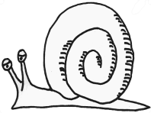

Pictorial Depiction of Amdahl’s Law
Enhancement E accelerates fraction F of original execution time by a factor of S
Before:
Execution Time without enhancement E: (Before enhancement is applied)
shown normalized to 1 = (1-F) + F =1
Unaffected fraction: (1- F)
Affected fraction: F
Unchanged
Unaffected fraction: (1- F)
F/S
After:
Execution Time with enhancement E:
What if the fraction given is
after the enhancement has been applied?
How would you solve the problem?
(i.e find expression for speedup)
Execution Time without enhancement E 1
Speedup(E) = ------------------------------------------------------ = ------------------
Execution Time with enhancement E (1 - F) + F/S

Slide 18
Example (RISC processor)
Base Machine (Reg / Reg)
Op Freq Cycles CPI(i) % Time
ALU 50% 1 .5 23%
Load 20% 5 1.0 45%
Store 10% 3 .3 14%
Branch 20% 2 .4 18%
2.2
Typical Mix
How much faster would the machine be if a better data cache
reduced the average load time to 2 cycles?
How does this compare with using branch prediction to shave a
cycle off the branch time?
What if two ALU instructions could be executed at once?

Slide 19
Summary: Evaluating Instruction Sets and Implementation
Design-time metrics:
° Can it be implemented, in how long, at what cost?
° Can it be programmed? Ease of compilation?
Static Metrics:
° How many bytes does the program occupy in memory?
Dynamic Metrics:
° How many instructions are executed?
° How many bytes does the processor fetch to execute the program?
° How many clocks are required per instruction?
° How "lean" a clock is practical?
Best Metric: Time to execute the program!
CPI
Inst. Count
Cycle Time
NOTE: this depends on instructions set, processor organization, and
compilation techniques.

Slide 20
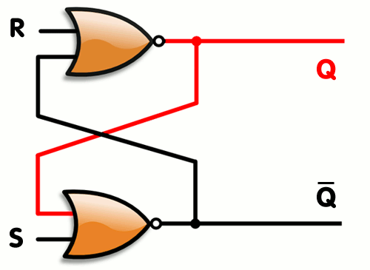
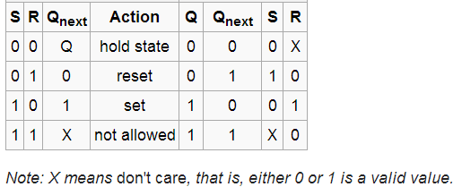
Flip-Flops ( Latches)
a flip-flop or latch is a circuit that has two stable states and can be used to store state information.
They are used as data storage elements.
Such data storage can be used for storage of state, and such a circuit is described as sequential logic.
When used in a finite-state machine, the output and next state depend not only on its current input, but also on its current state (and hence, previous inputs).
An SR latch, constructed from a pair of cross coupled NOR gates .
Red and black mean logical '1' and '0', respectively.

Slide 21
Finite State Machines:
System state is explicit in representation
Transitions between states represented as arrows with inputs on arcs.
Output may be either part of state or on arcs
1
“Mod 3 Machine”
Alpha/
0
Beta/
1
1
Input (MSB first)
0
0
106
1
1
0 1 0 1 0
0
Delta/
2
Mod 3
1
0
0 1 2 2 1
1
1

Slide 22
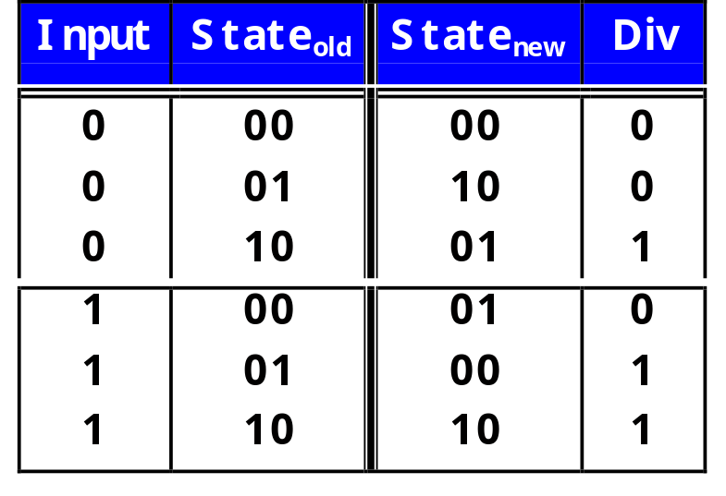
Implementation as Combinational logic + Latch
1/0
Alpha/
0
Beta/
1
1/1
0/0
0/1
Latch
“Moore Machine”
0/0
Delta/
2
Combinational
Logic
1/1
“Mealey Machine”

Slide 23
Performance and Technology Trends
1000
100
Supercomputers
Mainframes
10
Performance
Minicomputers
1
Microprocessors
0.1
1965
1970
1975
1980
1985
1990
1995
2000
Year
Technology Power: 1.2 x 1.2 x 1.2 = 1.7 x / year
  Feature Size: shrinks 10% / yr. => Switching speed improves 1.2 / yr.
  Density: improves 1.2x / yr.
  Die Area: 1.2x / yr.
The lesson of RISC is to keep the ISA as simple as possible:
  Shorter design cycle => fully exploit the advancing technology (~3yr)
  Advanced branch prediction and pipeline techniques
  Bigger and more sophisticated on-chip caches
Notes:
Recall the performance chart from the first lecture: performance of all computers advance in a rapid pace.
Even though computer architects like to think that this rapid increase in performance is caused by their clever ideas. Deep down, almost every one agrees that this rapid performance growth is caused by the technology that behinds it.
Here are some estimates to give you an idea on how rapidly the technology is evolving:
a. The feature size, that is the size of the transistor, is shrinking about 10% a year.
Smaller transistors means faster switching.
b. Technology advances also enables us to pack ~20% more components into
the same area every year.
c. Last but not least, we are able to manufacture chips that are 20% bigger every year.
Consequently, the advance in technology is enabling us to have 1.2 to the power of 3, or 1.7 times more computer power every year.
+2 = 6 min. (X:46)

Slide 24
Range of Design Styles
Custom Design
Standard Cell
Gate Array/FPGA/CPLD
Gates
Gates
Custom
ALU
Routing Channel
Standard
ALU
Custom Control Logic
Gates
Routing Channel
Custom
Register File
Standard Registers
Gates
Performance
Design Complexity (Design Time)
Compact
Longer wires
Notes:
Now you have the basic components, there are several design styles you can follow.
The cheapest and lowest performance design style is the gate array technology/FPGA/PLD.
The chip you produce consists of rows of logic gates and rows of routing channels.
Computer Aid Design (CAD) tools from the manufacturer can usually map your design into the available gates and route the design for you.
The manufacturer usually have the chips “prefab” to the points where all the gates are already made and all they need to when they receive your design is to put in all the routing wires that “customize” the chip for you.
Consequently, the gate array design style is the cheapest and has the shortest turn around time but also has the lowest performance.
On the other extreme of the spectrum is custom design. In this case, you design EVERYTHING. I don’t just mean logic design, but you also have to layout all the transistors.
This is the most time consuming design style but also has the potential to have the highest performance since you take advantage of every aspect of the technology.
Standard cell design is in the middle. In this case, the manufacturer has already design some common parts such as ALU, register file, MUX, ... etc. and place them in a library.
All you have to do and pick these components and connect them together.
One thing to keep in mind when you pick a design style is design time.
It may not do you any good if your design is slightly faster using the custom design style but it comes two years later than if your design is done in gate array!
But don’t forget, TIME IS MONEY!!!
+3 = 21 min. (Y:01)

